Slide 1

Credit Card Fraud Detection Capstone Project
Ujwal kesharwani
Manish Dabhade
Kyatham Nikhil

Slide 2
Introduction
Following are the goals of this Credit Fraud Detection Model
To build the most accurate model to detect the maximum credit card fraud transaction. We will also detect the different type of fraud transaction and their trends
Also we will performing the cost benefit analysis to check for final savings with the help of cost incurred before and after model building.

Slide 3
Problem Statement
To help Finex the detect fraud transaction and business impact of these fraud transaction
Build the most accurate model to detect the maximum credit card fraud transaction so as to reduce the fraud transaction
Identify the driver variables and understand their significance which are strong indicators of fraud transaction
Identify the outliers, if any, in the dataset and justify the same
Check and fix the imbalance and skewness in the data
Consider both technical and business aspects while building the model
Summarize the fraud detection predictions by using evaluation metrics like accuracy, sensitivity, specificity and precision. And also perform the cost benefit analysis check business impact of the fraud transactions

Slide 4
Business Goal
Finex company want to develop a machine learning model to detect fraudulent transactions based on the historical transactional data of customers with a pool of merchants.
01
Finex company to analyze the business impact of these fraudulent transactions and recommend the optimal ways that the bank can adopt to mitigate the fraud risks.
02
The company want to know the benefit of the model using cost benefit analysis
03

Slide 5
Solution Methodology : Data Exploration
fraudTrain.csv & fraudTest.csv contains all the information about the fraud transaction generated through various sources and their activities
The train file contains 1296675 rows and 23 columns
The test file contains 555719 rows and 23 columns
Out of 23 columns, 10 are numeric columns and 13 are non-numeric or categorical columns
We merged the train and test data into a single file credit_fraud.csv for model building.
The merged dataset contains 1852394 rows and 22 columns.
Out of 22 columns, 10 are numeric columns and 12 are non-numeric or categorical columns

Slide 6
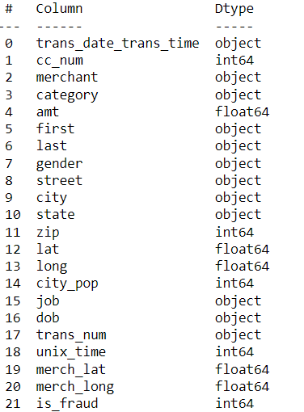
Solution Methodology : Data Cleaning and Preparation
Check for the shape and datatypes in the dataset. credit_fraud.csv:
Check for the null values.
Convert the incorrect datatypes to correct datatypes for
better results.
Binning the columns for better analysis.
Creation of new column
Drop columns that are not useful for the analysis.
Check and handle outliers in the dataset.

Slide 7
Solution Methodology : Data Cleaning and Preparation
Check for the null values
Few columns that are not required will delete those.
Check and handle outliers in data.

Slide 8

Solution Methodology : EDA and Findings
Univariate data analysis: value count, distribution of variable etc.
Bivariate data analysis: correlation coefficients and pattern between the variables etc.
Feature Scaling & Dummy Variables and encoding of the data.
Classification technique: Logistic Regression, Decision Tree & Random Forest used for the model making and prediction.
Validation of the model.
Model presentation.
Conclusions and recommendations.
Oversampling technique to fix data imbalance
Fixing the skewness in the data
Performing Cost Benefit Analysis

Slide 9
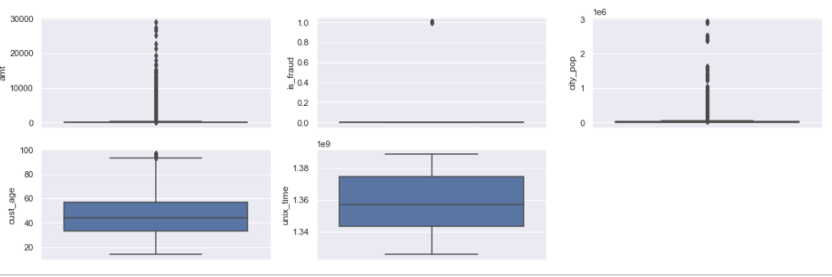
Check the outliers in the data set
Analysis:-
From the boxplot we can infer that There are no outliers in the dataset

Slide 10
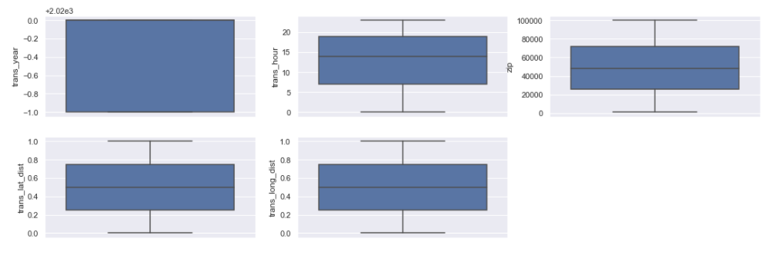
Check the outliers in the data set
Analysis:-
From the boxplot we can infer that There are no outliers in the datase

Slide 11
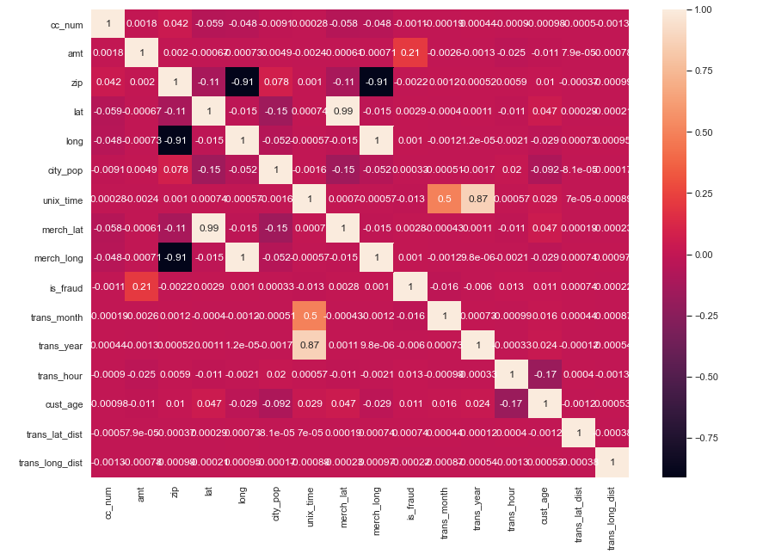
Visualizing correlation in Dataset
Analysis:
It can be seen that merch_lat and lat, merch_long and long are positively correlated whereas merch_long and zip are negatively correlated. we can remove one of the correlated columns

Slide 12
Univariate Analysis For Categorical Columns and Numerical Columns

Slide 13
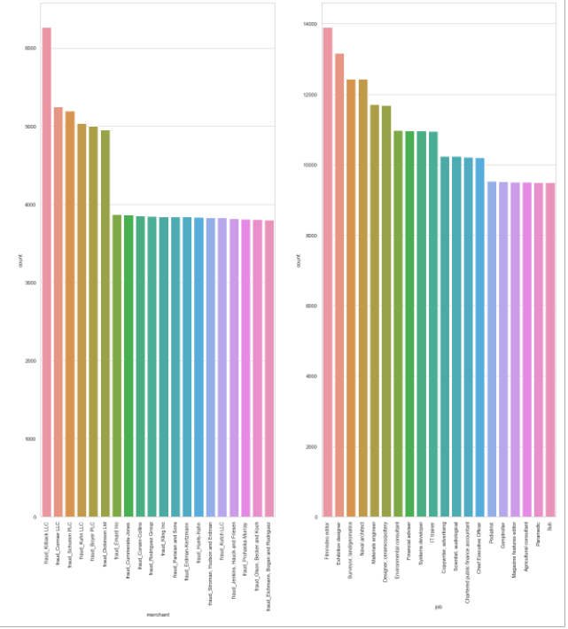
Univariate Analysis for Categorical Columns
Analysis:-
The merchant fraud_Killback_LLC mostly accepts credit card for transactions.
The people in Film/Video Editor & Exibition Desinger makes maximum use of transaction via credit card.

Slide 14
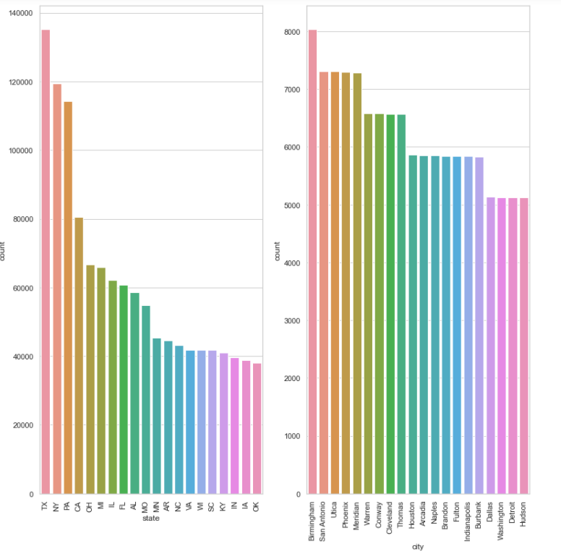
Univariate Analysis for Categorical Columns
Analysis:-
The Texas state use credit card for performing transaction.
The people living in Birmingham do highest transaction among other cities via credit card.

Slide 15
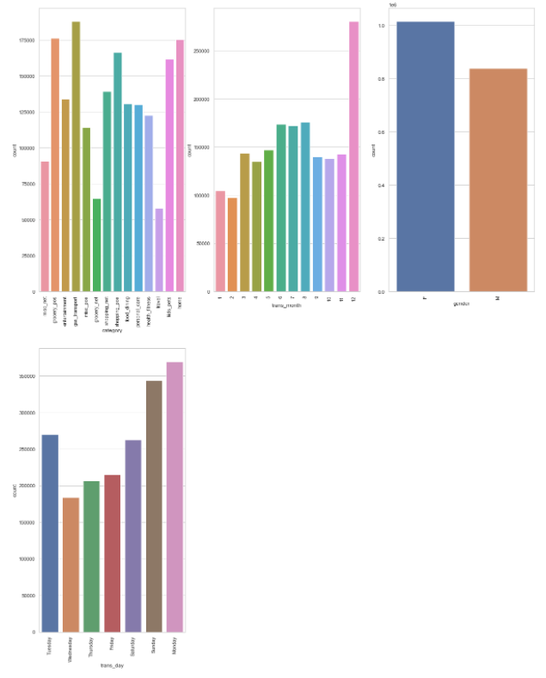
Univariate Analysis for Categorical Columns
Analysis:-
Gas_transport and grocery_pos categories are the highest transaction dealing categories.
The maximum transactions are done on Monday and Sunday.
The month of December reported the maximum number of transaction.
The females do more transaction than males.

Slide 16
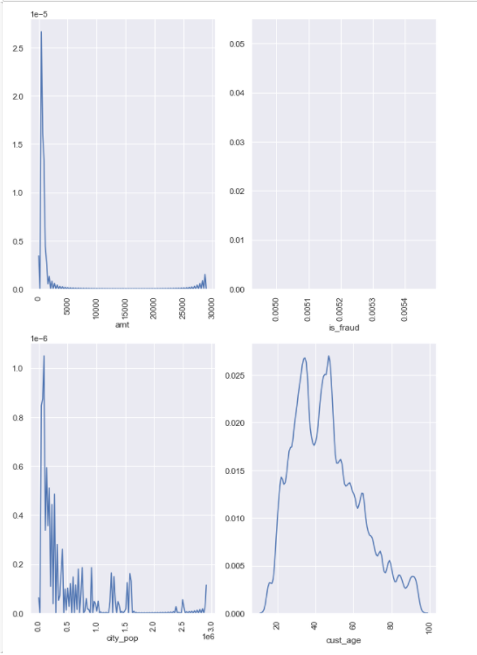
Univariate Analysis for Numeric Columns
Analysis:-
The most of transaction done by credit card is of 1000 and very few transaction of above 5000
The people of city with a population of 0.2 are doing maximum transaction via credit card.
The people with a age of 35 and 45 are doing maximum number of transaction.

Slide 17
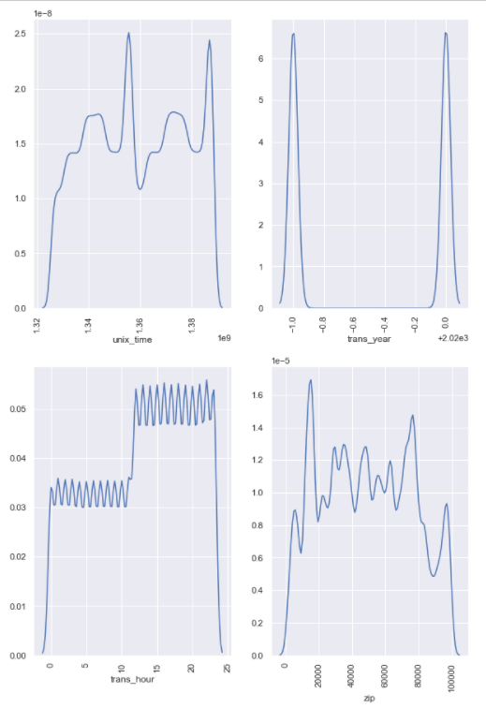
Univariate Analysis for Numeric Columns
Analysis:-
The most of the transaction are at between unix time between 1.35-1.36 and at 1.39.
The majority transaction are happening between 11:00 AM - 12:00 Midnight and the minimum transaction are done between 12:00 AM -11:00AM.
The people do less transaction in the morning and more transaction in afternoon and night.
The city with the zip code of 17000 has the maximum number of transactions
There are similar number of transactions in both the years

Slide 18
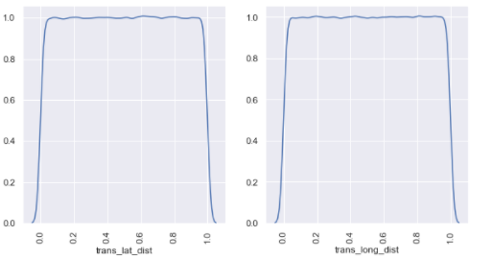
Univariate Analysis for Numeric Columns
Analysis:-
There are constant number of transaction at a latitude distance between 0.1-1.0
There are constant number of transaction with a latitude distance between 0.1-1.0

Slide 19
Bivariate Analysis For Categorical and Numeric Variables

Slide 20
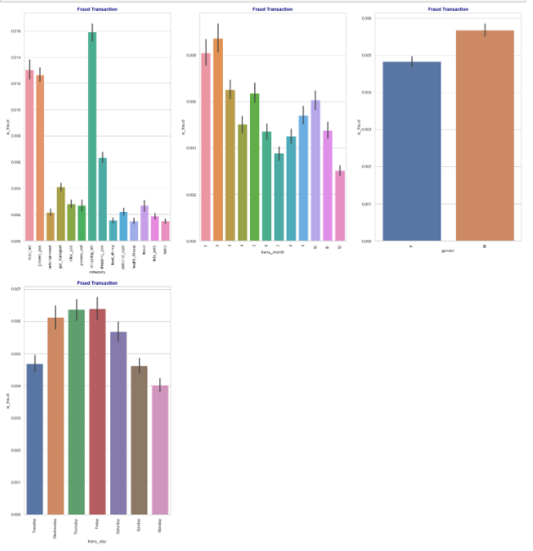
Bivariate Analysis For Categorical variables
Analysis:-
The maximum fraud transaction is done for the category 'shopping_net'
The month of February has reported the maximum transaction that were fraud.
The fraud transaction reported for male are more than female.
The maximum number of fraud transaction are done on Thursday and Friday.

Slide 21
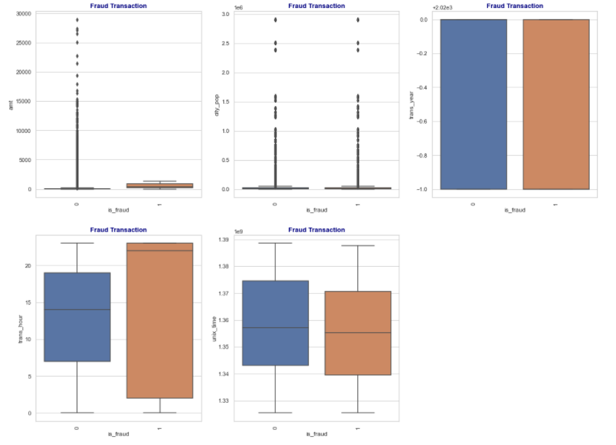
Bivariate Analysis For Numerical variables
Analysis:-
The fraud transaction ammount is more than non-fraud transaction.
The fraud transaction is same in both the year.
The fraud transaction are more in the early morning and in late night than non-fraud transaction.
However in the afternoon fraud and non-fraud transaction are same.
The maximum fraud transaction are reported at unic time 1.34.

Slide 22
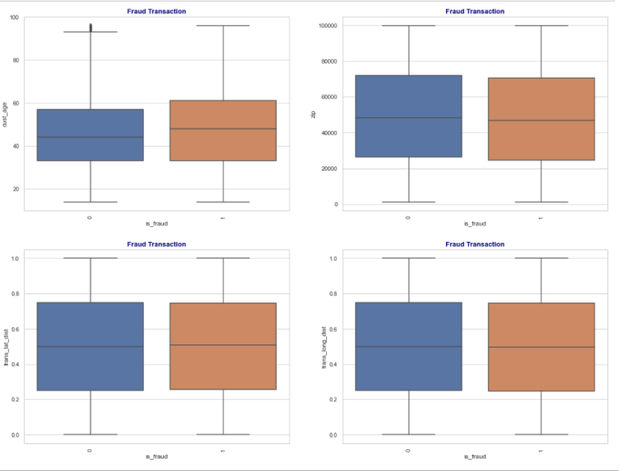
Bivariate Analysis For Numerical variables
Analysis:-
The fraud transaction and non-transaction are constant with respect too the city population
The zip of the fraud and non-fraud transaction is similar
The people with a age of 60 have reported maximum fraud transaction.
The latitude and longitude distance of transaction and merchant are same for both fraud and non-fraud transaction.

Slide 23
Bivariate Analysis For Numerical variables
Analysis:-
The fraud transaction and non-transaction are constant with respect too the city population
The zip of the fraud and non-fraud transaction is similar
The people with a age of 60 have reported maximum fraud transaction.
The latitude and longitude distance of transaction and merchant are same for both fraud and non-fraud transaction.

Slide 24

Data Preparation for Modeling
Create Dummy Variables:
Independent variables as dummy variables allows easy interpretation and calculation of the odds ratios, which increases the stability and significance of the coefficients.

Slide 25
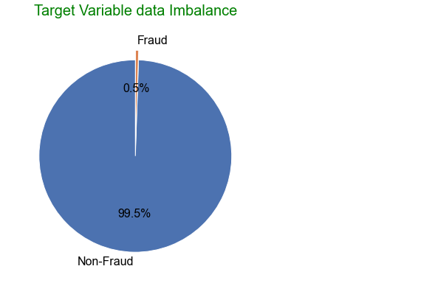
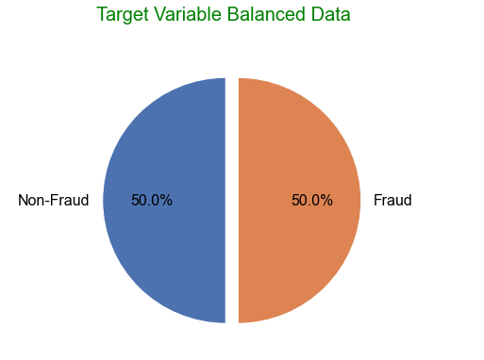
Data Imbalance

Slide 26
Data Preparation for Modeling
Train- Test Split
The modified ‘ dataset has been split into Train and test dataset in the ratio 70 30
Train dataset has been used to train the model whereas Test dataset has been used to evaluate the model

Slide 27
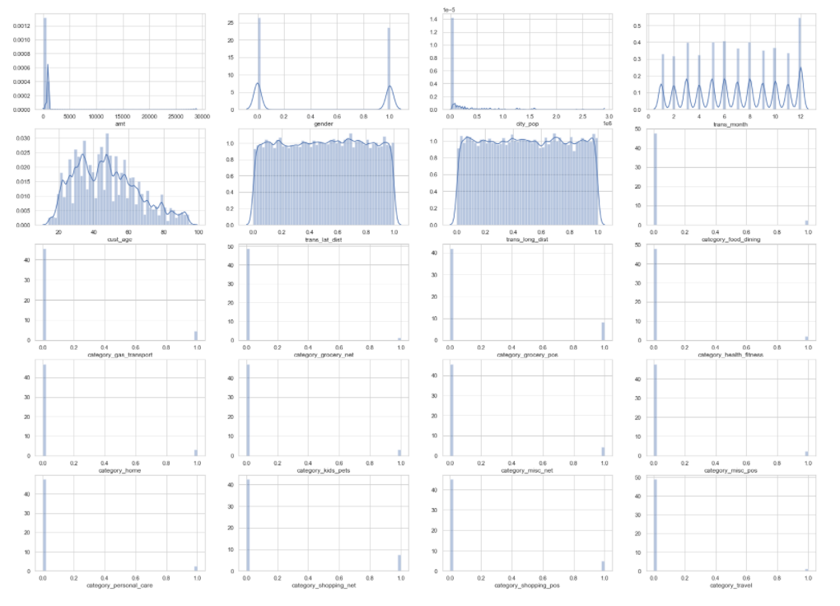
Skewed Data
Analysis:-
We see that the data is not evenly distributed as there is skewness in the data that will not give good result during model building.

Slide 28

Unskewed Data
Analysis:-
We can see the data is unskewed so the now is best suitable for model building.

Slide 29
Model Building: Using Logistic Regression
Feature Selection using Recursive Feature Elimination (RFE)
RFE is an optimization technique for finding the best performing subset of features It is based on the idea of repeatedly constructing a model and choosing either the best (based on coefficients), setting the feature aside and then repeating the process with the rest of the features This process is applied until all the features in the dataset are exhausted Features are then ranked according to when they were eliminated.
We ran RFE with 20 variables for further model building process
Insignificant features were dropped one by one after checking the P value and Variance Inflation Factor

Slide 30
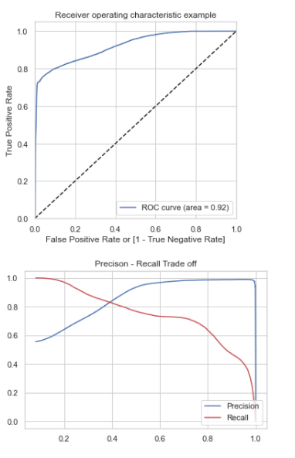
Measuring Model Performance
Sensitivity (Recall):
0.7672231101823273
Specificity:
0.9471088016052823
Precision:
0.935524177960679
F-Score:
0.843056129895273

Slide 31
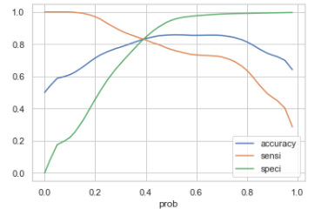
Finding Optimal Cut-off
Optimum cut-off value is: 0.4

Slide 32
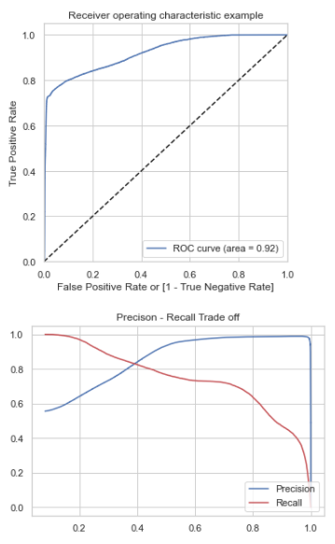
Measuring Performance on Train Set
Accuracy:
0.8343598827834284
Sensitivity (Recall): 0.8255605388117802
Specificity: 0.8431616555869313
Precision: 0.8403886896519074
F-Score:
0.8329086236081259
Finally, we have an overall accuracy of approx. 0.8 on our Logistic Regression model.

Slide 33
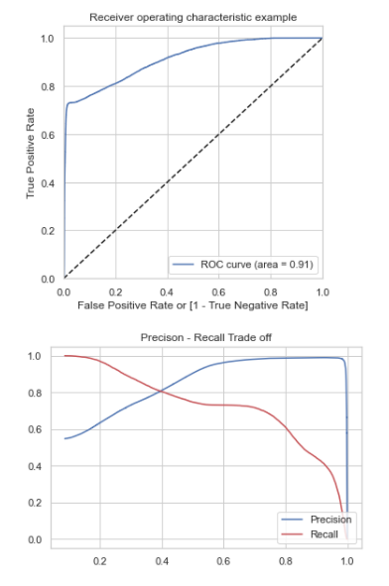
Measuring Performance on Test Set
Accuracy:
0.8090084891547565
Sensitivity (Recall):
0.8051533986555565
Specificity: 0.8128610979003654
Precision: 0.8113089203795409
F-Score: 0.8082194393409482
We have an overall accuracy of approx. 0.80 on our Logistic Regression model.

Slide 34
Model Building: Using Decision Tree
Measuring Performance on Train Set
Accuracy:
0.9888454322748698
Sensitivity (Recall):
0.9961700583986642
Precision:
0.981790582531763
Analysis:-
We are getting accuracy of 98 % on both train and test data set
Measuring Performance on Test Set
Accuracy:
0.9886419342176429
Sensitivity (Recall):
0.9814253242412088
Precision:
0.9961295225687377

Slide 35
Model Building: Using Random Forest
Measuring Performance on Train Set
Analysis:-
We are getting accuracy of 90 % on both train and test data set
Accuracy:
0.9021435437856611
Sensitivity (Recall):
0.8314833446761409
Precision:
0.9683582698560862
Measuring Performance on Test Set
Accuracy:
0.9023557268782232
Sensitivity (Recall):
0.9961700583986642
Precision:
0.8315663762451483

Slide 36

Evaluation Metrics
After evaluating all the three models we will using the Decision Tree model for the cost benefit analysis. As the predicted data we get from the Decision Tree Model because its accuracy, precision and recall percentage is highest among all the models.
Accuracy: 98%
Precision: 98%
Recall: 99%

Slide 37
Cost Benefit Analysis
After the model has been built and evaluated with the appropriate metrics, we need to demonstrate its potential benefits by performing a cost-benefit analysis which can then be presented to the relevant business stakeholders.
To perform this analysis, you need to compare the costs incurred before and after the model is deployed. Earlier, the bank paid the entire transaction amount to the customer for every fraudulent transaction which accounted for a heavy loss to the bank.
We will perform the following calculations sequentially to arrive at the final savings that your model can potentially provide to Finex.

Slide 38
Current Loss Incurred
Average number of transactions per month | 77183.1
Average number of fraudulent transaction per month | 402.12
Average amount per fraud transaction | 530.66
Cost incurred per month before the model was deployed | 213389

Slide 39
Analysis After Model Building
Average number of transactions per month detected as fraudulent by the model (TF) | 31890.62
Cost of providing customer executive support per fraudulent transaction detected by the model | $1.5
Total cost of providing customer support per month for fraudulent transactions detected by the model (TF*$1.5) | 47997.12
Average number of transactions per month that are fraudulent but not detected by the model (FN) | 233.29
Cost incurred due to fraudulent transactions left undetected by the model (FN*c) | 123797.67
Cost incurred per month after the model is built and deployed (4+6) | 171794.79
Final savings = Cost incurred before - Cost incurred after(1-7) | 41467.07

Slide 40
SUMMARY

Slide 41

Findings
The males are more prone to fraud transaction
People do more transaction from 11:00 AM to 11:00 PM
The fraud transaction generally happens in the later night
Maximum fraud transaction happens on Sunday and Monday.
December reported maximum number of fraud transaction.
People between the age of 50-60 are more prone to fraud transaction.

Slide 42
Findings
Following three variables are contributing the most towards the probability of a lead getting converted:
Amount
Category
Gender
Again, based on the coefficient values the following are the top three categorical/dummy variables that should be focused the most in regarding the fraud transaction:
gas_transport,
grocery_pos
shopping_pos

Slide 43
Conclusion and Recommendations
233.29
The fraud transaction detected by model is more than fraud transaction undetected by the model.
Average number of transactions per month detected as fraud by the model is 31890.62
Average number of transactions per month not detected as fraud by the model is 233.29
The cost incurred after the model is built is less than cost before the model is built.
Cost incurred per month before the model was deployed is 213389
Cost incurred per month after the model was deployed is 171794.79
Final saving of 41594.21

Slide 44
Conclusion and Recommendations
We have use Decision Tree Model with an Accuracy of 98%,
Precision of 98% and Recall of 99%.
We will using this model because of its high accuracy among all the three models.
To perform the cost benefit analysis this model is best.
This model detects high number of fraud cases.
This model is cost effective.
Hence overall this model seems to be good.

Slide 45
Attached Files
Raising Fraud Root Cause Analysis
Structured Problem Solving
Cost Benefit Analysis
Credit Card Fraud Detection Capstone Project File
fraudTrain and fraudTest Dataset.

Slide 46
THANK YOU

